Slide 1
RUSTikales Rust for beginners
©Philippe Felix Haupt 2023

Slide 2
Plan for today
©Philippe Felix Haupt 2023

Slide 3
Plan for today
Recap
©Philippe Felix Haupt 2023

Slide 4
Plan for today
Recap
Arrays and Vectors
©Philippe Felix Haupt 2023

Slide 5
Plan for today
Recap
Arrays and Vectors
Basics
©Philippe Felix Haupt 2023

Slide 6
Plan for today
Recap
Arrays and Vectors
Basics
Getting and Setting elements
©Philippe Felix Haupt 2023

Slide 7
Plan for today
Recap
Arrays and Vectors
Basics
Getting and Setting elements
Common operations
©Philippe Felix Haupt 2023

Slide 8
Recap
©Philippe Felix Haupt 2023

Slide 9
Recap
Basic types: integer, float, boolean, char
©Philippe Felix Haupt 2023

Slide 10
Recap
Basic types: integer, float, boolean, char
Integer types in Rust: i8, u8, i16, u16, …, i128, u128
©Philippe Felix Haupt 2023

Slide 11
Recap
Basic types: integer, float, boolean, char
Integer types in Rust: i8, u8, i16, u16, …, i128, u128
The number tells us how much memory the variable takes
©Philippe Felix Haupt 2023

Slide 12
Recap
Basic types: integer, float, boolean, char
Integer types in Rust: i8, u8, i16, u16, …, i128, u128
The number tells us how much memory the variable takes
Higher number → More bits → Bigger number possible
©Philippe Felix Haupt 2023

Slide 13
Recap
Basic types: integer, float, boolean, char
Integer types in Rust: i8, u8, i16, u16, …, i128, u128
The number tells us how much memory the variable takes
Higher number → More bits → Bigger number possible
`let` declares an immutable variable
©Philippe Felix Haupt 2023

Slide 14
Recap
Basic types: integer, float, boolean, char
Integer types in Rust: i8, u8, i16, u16, …, i128, u128
The number tells us how much memory the variable takes
Higher number → More bits → Bigger number possible
`let` declares an immutable variable
`let mut` declares a mutable variable
©Philippe Felix Haupt 2023

Slide 15
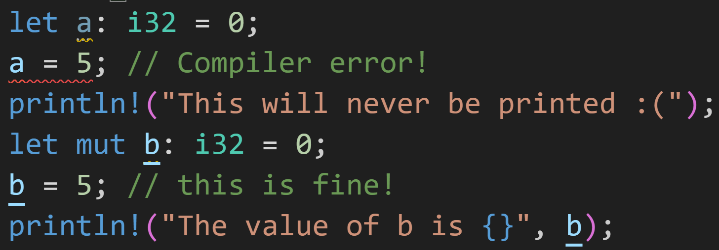
Recap
Basic types: integer, float, boolean, char
Integer types in Rust: i8, u8, i16, u16, …, i128, u128
The number tells us how much memory the variable takes
Higher number → More bits → Bigger number possible
`let` declares an immutable variable
`let mut` declares a mutable variable
©Philippe Felix Haupt 2023

Slide 16
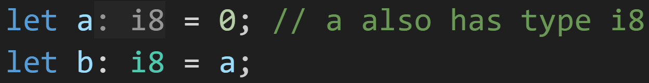
Recap
Type Inference allows us to omit the type declaration
©Philippe Felix Haupt 2023

Slide 17
Recap
Type Inference allows us to omit the type declaration
Feedback was: Very confusing → I will not be omitting types in examples from now on
©Philippe Felix Haupt 2023

Slide 18
Recap
Exercises
Did you look at them?
©Philippe Felix Haupt 2023

Slide 19
Recap
Exercises
Did you look at them?
Did you understand them?
©Philippe Felix Haupt 2023

Slide 20
Recap
Exercises
Did you look at them?
Did you understand them?
Were you able to solve them?
©Philippe Felix Haupt 2023

Slide 21
Recap
Exercises
Did you look at them?
Did you understand them?
Were you able to solve them?
We’ll be going through them now
©Philippe Felix Haupt 2023

Slide 22
Recap
Exercises
Did you look at them?
Did you understand them?
Were you able to solve them?
Important to know:
©Philippe Felix Haupt 2023

Slide 23
Recap
Exercises
Did you look at them?
Did you understand them?
Were you able to solve them?
Important to know:
Rust only performs most arithmetic checks (e.g. Overflow) in Debug mode, not Release mode
©Philippe Felix Haupt 2023

Slide 24
Recap
Exercises
Did you look at them?
Did you understand them?
Were you able to solve them?
Important to know:
Rust only performs most arithmetic checks (e.g. Overflow) in Debug mode, not Release mode
use cargo run --release to enable Release mode
enables all* optimizations
©Philippe Felix Haupt 2023

Slide 25
Recap
Exercises
Did you look at them?
Did you understand them?
Were you able to solve them?
Important to know:
Rust only performs most arithmetic checks (e.g. Overflow) in Debug mode, not Release mode
Default type for integers is i32
©Philippe Felix Haupt 2023

Slide 26
Recap
Exercises
Did you look at them?
Did you understand them?
Were you able to solve them?
Important to know:
Rust only performs most arithmetic checks (e.g. Overflow) in Debug mode, not Release mode
Default type for integers is i32
Integer division truncates the result (rounds toward 0)
Use floats (f32, f64) if the decimals are important
©Philippe Felix Haupt 2023

Slide 27
Recap
Exercises
Did you look at them?
Did you understand them?
Were you able to solve them?
Important to know:
Rust only performs most arithmetic checks (e.g. Overflow) in Debug mode, not Release mode
Default type for integers is i32
Integer division truncates the result (rounds toward 0)
Type implementations come with additional constants to make life easier, for example:
i8::MIN is the lowest value an i8 can hold
u128::MAX is the biggest value an u128 can hold
u64::BITS shows how many bits an u64 takes up
©Philippe Felix Haupt 2023

Slide 28
Recap
Exercises
Did you look at them?
Did you understand them?
Were you able to solve them?
Important to know:
Rust only performs most arithmetic checks (e.g. Overflow) in Debug mode, not Release mode
Default type for integers is i32
Integer division truncates the result (rounds toward 0)
Type implementations come with additional constants to make life easier
Type limits are bounding, there’s no way of storing more than that
If your bottle can only hold 2 liters of water, you can’t fill it with 10 liters
Overflows in Programming get truncated to fit:
1000 as u8 = 1000 % 256 = 232 gets stored in variable, Rest is lost
There’s no physical space for the other bits, use a bigger type if you need bigger numbers
©Philippe Felix Haupt 2023

Slide 29
2. Arrays and Vectors - Basics
©Philippe Felix Haupt 2023

Slide 30
2. Arrays and Vectors - Basics
Arrays and Vectors are collections of variables
©Philippe Felix Haupt 2023

Slide 31
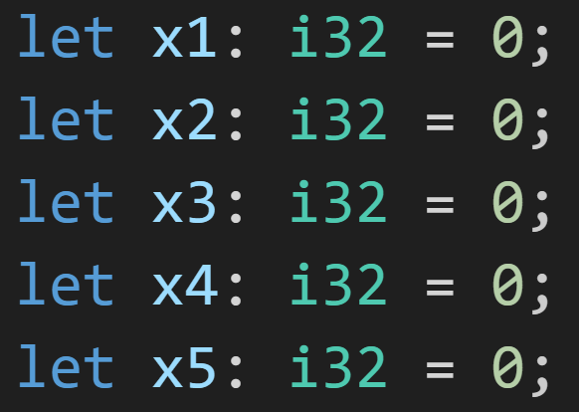
2. Arrays and Vectors - Basics
Arrays and Vectors are collections of variables
©Philippe Felix Haupt 2023

Slide 32

2. Arrays and Vectors - Basics
Arrays and Vectors are collections of variables
©Philippe Felix Haupt 2023

Slide 33
2. Arrays and Vectors - Basics
Array of i32, with 5 elements
Arrays and Vectors are collections of variables
Vector of i32
©Philippe Felix Haupt 2023

Slide 34
2. Arrays and Vectors - Basics
Arrays and Vectors are collections of variables
Collections of variables with the same type
©Philippe Felix Haupt 2023

Slide 35
2. Arrays and Vectors - Basics
Arrays and Vectors are collections of variables
Collections of variables with the same type
©Philippe Felix Haupt 2023

Slide 36
2. Arrays and Vectors - Basics
Arrays and Vectors are collections of variables
Collections of variables with the same type
Inferred i32
©Philippe Felix Haupt 2023

Slide 37
2. Arrays and Vectors - Basics
Arrays and Vectors are collections of variables
Collections of variables with the same type
Inferred i32
u32 is not i32
©Philippe Felix Haupt 2023

Slide 38
2. Arrays and Vectors - Basics
Arrays and Vectors are collections of variables
Collections of variables with the same type
Arrays have a fixed size, Vectors are resizable
©Philippe Felix Haupt 2023

Slide 39
2. Arrays and Vectors - Basics
Arrays and Vectors are collections of variables
Collections of variables with the same type
Arrays have a fixed size, Vectors are resizable
Array size is specified when declaring them
©Philippe Felix Haupt 2023

Slide 40
2. Arrays and Vectors - Basics
Arrays and Vectors are collections of variables
Collections of variables with the same type
Arrays have a fixed size, Vectors are resizable
Array size is specified when declaring them
©Philippe Felix Haupt 2023

Slide 41
2. Arrays and Vectors - Basics
Arrays and Vectors are collections of variables
Collections of variables with the same type
Arrays have a fixed size, Vectors are resizable
Array size is specified when declaring them
5 elements
©Philippe Felix Haupt 2023

Slide 42
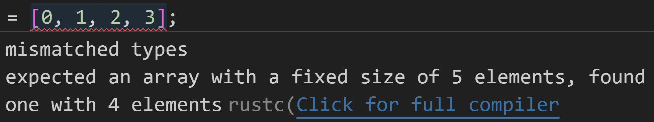
2. Arrays and Vectors - Basics
Arrays and Vectors are collections of variables
Collections of variables with the same type
Arrays have a fixed size, Vectors are resizable
Array size is specified when declaring them
5 elements
if you don’t write 5 values here, Rust will complain:
©Philippe Felix Haupt 2023

Slide 43
2. Arrays and Vectors - Basics
Arrays and Vectors are collections of variables
Collections of variables with the same type
Arrays have a fixed size, Vectors are resizable
Array size is specified when declaring them
©Philippe Felix Haupt 2023

Slide 44
2. Arrays and Vectors - Basics
Arrays and Vectors are collections of variables
Collections of variables with the same type
Arrays have a fixed size, Vectors are resizable
Array size is specified when declaring them
Specifying 1000 elements may take a while
©Philippe Felix Haupt 2023

Slide 45
2. Arrays and Vectors - Basics
Arrays and Vectors are collections of variables
Collections of variables with the same type
Arrays have a fixed size, Vectors are resizable
Array size is specified when declaring them
Specifying 1000 elements may take a while
Short form: Creates an array of size 1000, and fills it with zeros
©Philippe Felix Haupt 2023

Slide 46
2. Arrays and Vectors - Basics
Arrays and Vectors are collections of variables
Collections of variables with the same type
Arrays have a fixed size, Vectors are resizable
Array size is specified when declaring them
In general: Fills the array with whatever is here
©Philippe Felix Haupt 2023

Slide 47
2. Arrays and Vectors - Basics
Arrays and Vectors are collections of variables
Collections of variables with the same type
Arrays have a fixed size, Vectors are resizable
Array size is specified when declaring them
Vectors have internal capacity, they are resized automatically when adding too many elements
©Philippe Felix Haupt 2023

Slide 48
2. Arrays and Vectors - Basics
Arrays and Vectors are collections of variables
Collections of variables with the same type
Arrays have a fixed size, Vectors are resizable
Array size is specified when declaring them
Vectors have internal capacity, they are resized automatically when adding too many elements
©Philippe Felix Haupt 2023

Slide 49
2. Arrays and Vectors - Basics
Arrays and Vectors are collections of variables
Collections of variables with the same type
Arrays have a fixed size, Vectors are resizable
Array size is specified when declaring them
Vectors have internal capacity, they are resized automatically when adding too many elements
Vector of i32
©Philippe Felix Haupt 2023

Slide 50
2. Arrays and Vectors - Basics
Arrays and Vectors are collections of variables
Collections of variables with the same type
Arrays have a fixed size, Vectors are resizable
Array size is specified when declaring them
Vectors have internal capacity, they are resized automatically when adding too many elements
Vector of i32
We’re accessing something in the Vec implementation,
this time we want to call a function from there
©Philippe Felix Haupt 2023

Slide 51
2. Arrays and Vectors - Basics
Arrays and Vectors are collections of variables
Collections of variables with the same type
Arrays have a fixed size, Vectors are resizable
Array size is specified when declaring them
Vectors have internal capacity, they are resized automatically when adding too many elements
Vector of i32
new() creates a new Vector with capacity 0
©Philippe Felix Haupt 2023

Slide 52
2. Arrays and Vectors - Basics
Arrays and Vectors are collections of variables
Collections of variables with the same type
Arrays have a fixed size, Vectors are resizable
Array size is specified when declaring them
Vectors have internal capacity, they are resized automatically when adding too many elements
You can specify initial capacity using Vec::with_capacity() instead of Vec::new()
©Philippe Felix Haupt 2023

Slide 53
2. Arrays and Vectors - Basics
Arrays and Vectors are collections of variables
Collections of variables with the same type
Arrays have a fixed size, Vectors are resizable
Array size is specified when declaring them
Vectors have internal capacity, they are resized automatically when adding too many elements
You can specify initial capacity using Vec::with_capacity() instead of Vec::new()
BUT: capacity does not equal amount of elements! It just says how many can fit in there
©Philippe Felix Haupt 2023

Slide 54
2. Arrays and Vectors - Basics
Arrays and Vectors are collections of variables
Collections of variables with the same type
Arrays have a fixed size, Vectors are resizable
Array size is specified when declaring them
Vectors have internal capacity, they are resized automatically when adding too many elements
You can specify initial capacity using Vec::with_capacity() instead of Vec::new()
BUT: capacity does not equal amount of elements! It just says how many can fit in there
Gets resized* the first time you add an element
©Philippe Felix Haupt 2023

Slide 55
2. Arrays and Vectors - Basics
Arrays are located on the Stack, Vectors are on the Heap
©Philippe Felix Haupt 2023

Slide 56
2. Arrays and Vectors - Basics
Arrays are located on the Stack, Vectors are on the Heap
Generally: Stack access is quicker than Heap access
©Philippe Felix Haupt 2023

Slide 57
2. Arrays and Vectors - Basics
Arrays are located on the Stack, Vectors are on the Heap
Generally: Stack access is quicker than Heap access
Heap needs to be allocated
Heap may have Pointer-Overhead
Heap needs to be de-allocated
©Philippe Felix Haupt 2023

Slide 58
2. Arrays and Vectors - Basics
Arrays are located on the Stack, Vectors are on the Heap
Generally: Stack access is quicker than Heap access
Heap needs to be allocated
Heap may have Pointer-Overhead
Heap needs to be de-allocated
If you know the size of your Vector, and never add or remove any elements, it’s always better to use an Array instead
©Philippe Felix Haupt 2023

Slide 59
2. Arrays and Vectors - Basics
Arrays are located on the Stack, Vectors are on the Heap
Generally: Stack access is quicker than Heap access
Heap needs to be allocated
Heap may have Pointer-Overhead
Heap needs to be de-allocated
If you know the size of your Vector, and never add or remove any elements, it’s always better to use an Array instead
Arrays and Vectors are zero-indexed
©Philippe Felix Haupt 2023

Slide 60
2. Arrays and Vectors - Basics
Arrays are located on the Stack, Vectors are on the Heap
Generally: Stack access is quicker than Heap access
Heap needs to be allocated
Heap may have Pointer-Overhead
Heap needs to be de-allocated
If you know the size of your Vector, and never add or remove any elements, it’s always better to use an Array instead
Arrays and Vectors are zero-indexed
©Philippe Felix Haupt 2023

Slide 61
2. Arrays and Vectors - Basics
Arrays are located on the Stack, Vectors are on the Heap
Generally: Stack access is quicker than Heap access
Heap needs to be allocated
Heap may have Pointer-Overhead
Heap needs to be de-allocated
If you know the size of your Vector, and never add or remove any elements, it’s always better to use an Array instead
Arrays and Vectors are zero-indexed
Element at index 0 is 420
©Philippe Felix Haupt 2023

Slide 62
2. Arrays and Vectors - Basics
Arrays are located on the Stack, Vectors are on the Heap
Generally: Stack access is quicker than Heap access
Heap needs to be allocated
Heap may have Pointer-Overhead
Heap needs to be de-allocated
If you know the size of your Vector, and never add or remove any elements, it’s always better to use an Array instead
Arrays and Vectors are zero-indexed
Element at index 0 is 420
Element at index 1 is 69
©Philippe Felix Haupt 2023

Slide 63
2. Arrays and Vectors - Basics
Arrays are located on the Stack, Vectors are on the Heap
Generally: Stack access is quicker than Heap access
Heap needs to be allocated
Heap may have Pointer-Overhead
Heap needs to be de-allocated
If you know the size of your Vector, and never add or remove any elements, it’s always better to use an Array instead
Arrays and Vectors are zero-indexed
Element at index 0 is 420
Element at index 2 is 1337
Element at index 1 is 69
©Philippe Felix Haupt 2023

Slide 64
Intermission: The vec! macro
Imagine you want to declare a Vector with 5 elements
©Philippe Felix Haupt 2023

Slide 65
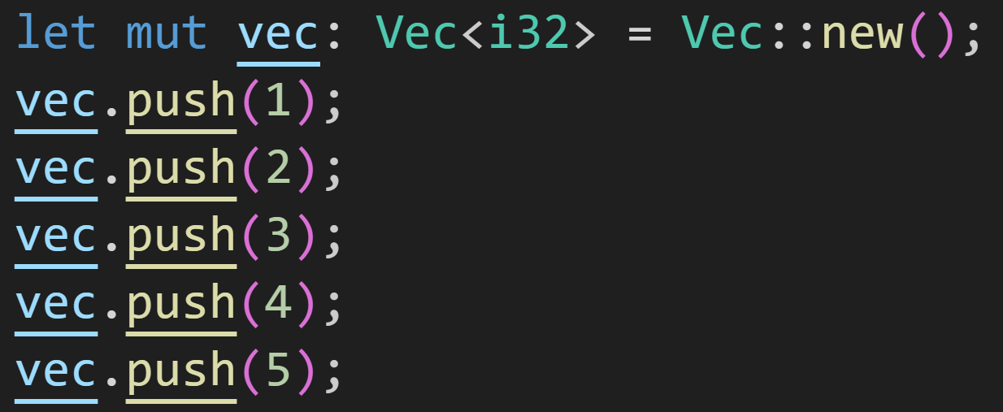
Intermission: The vec! macro
Imagine you want to declare a Vector with 5 elements
©Philippe Felix Haupt 2023

Slide 66
Intermission: The vec! macro
Imagine you want to declare a Vector with 5 elements
Declare Vector
©Philippe Felix Haupt 2023

Slide 67
Intermission: The vec! macro
Imagine you want to declare a Vector with 5 elements
Fill Vector
©Philippe Felix Haupt 2023

Slide 68
Intermission: The vec! macro
Imagine you want to declare a Vector with 5 elements
6 lines of code! That’s a lot of work!
Now imagine filling it with 10 elements!
©Philippe Felix Haupt 2023

Slide 69
Intermission: The vec! macro
Imagine you want to declare a Vector with 5 elements
Introducing: The vec!-macro
©Philippe Felix Haupt 2023

Slide 70
Intermission: The vec! macro
Imagine you want to declare a Vector with 5 elements
Introducing: The vec!-macro
Arrays and Vectors share a lot of similarities
with this macro we add declaration to that list
©Philippe Felix Haupt 2023

Slide 71
Intermission: The vec! macro
Imagine you want to declare a Vector with 5 elements
Introducing: The vec!-macro
Arrays and Vectors share a lot of similarities
with this macro we add declaration to that list
©Philippe Felix Haupt 2023

Slide 72
Intermission: The vec! macro
Imagine you want to declare a Vector with 5 elements
Introducing: The vec!-macro
Arrays and Vectors share a lot of similarities
with this macro we add declaration to that list
Create a Vector
©Philippe Felix Haupt 2023

Slide 73
Intermission: The vec! macro
Imagine you want to declare a Vector with 5 elements
Introducing: The vec!-macro
Arrays and Vectors share a lot of similarities
with this macro we add declaration to that list
Create a Vector
Fill with those values!
©Philippe Felix Haupt 2023

Slide 74
Intermission: The vec! macro
Imagine you want to declare a Vector with 5 elements
Introducing: The vec!-macro
Arrays and Vectors share a lot of similarities
with this macro we add declaration to that list
©Philippe Felix Haupt 2023

Slide 75
Intermission: The vec! macro
Imagine you want to declare a Vector with 5 elements
Introducing: The vec!-macro
Arrays and Vectors share a lot of similarities
with this macro we add declaration to that list
Create a Vector
©Philippe Felix Haupt 2023

Slide 76
Intermission: The vec! macro
Imagine you want to declare a Vector with 5 elements
Introducing: The vec!-macro
Arrays and Vectors share a lot of similarities
with this macro we add declaration to that list
Create a Vector
Push a 5 … 1000 times!
©Philippe Felix Haupt 2023

Slide 77
Intermission: The vec! macro
Imagine you want to declare a Vector with 5 elements
Introducing: The vec!-macro
Arrays and Vectors share a lot of similarities
vec! has one benefit over normal Array declarations:
The size argument can be dynamic!
©Philippe Felix Haupt 2023

Slide 78
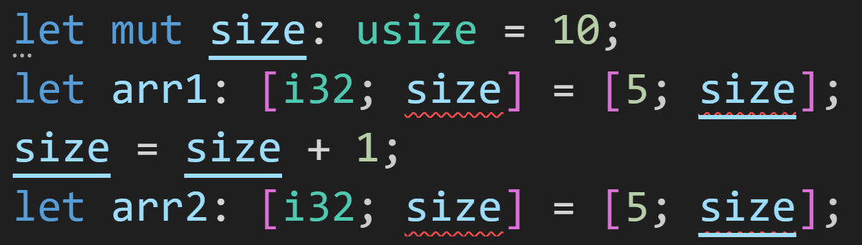
Intermission: The vec! macro
Imagine you want to declare a Vector with 5 elements
Introducing: The vec!-macro
Arrays and Vectors share a lot of similarities
vec! has one benefit over normal Array declarations:
The size argument can be dynamic!
©Philippe Felix Haupt 2023

Slide 79
Intermission: The vec! macro
For arrays, this needs to be known at compile-time
Imagine you want to declare a Vector with 5 elements
Introducing: The vec!-macro
Arrays and Vectors share a lot of similarities
vec! has one benefit over normal Array declarations:
The size argument can be dynamic!
©Philippe Felix Haupt 2023

Slide 80
Intermission: The vec! macro
Imagine you want to declare a Vector with 5 elements
Introducing: The vec!-macro
Arrays and Vectors share a lot of similarities
vec! has one benefit over normal Array declarations:
The size argument can be dynamic!
size is determined at runtime
©Philippe Felix Haupt 2023

Slide 81
Intermission: The vec! macro
Imagine you want to declare a Vector with 5 elements
Introducing: The vec!-macro
Arrays and Vectors share a lot of similarities
vec! has one benefit over normal Array declarations:
The size argument can be dynamic!
Not dynamic at all!
©Philippe Felix Haupt 2023

Slide 82
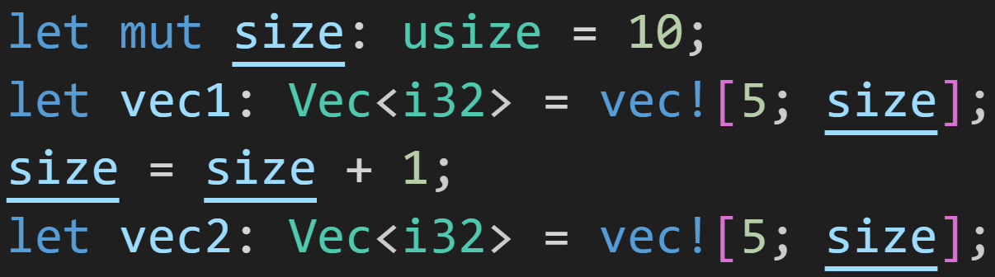
Intermission: The vec! macro
Imagine you want to declare a Vector with 5 elements
Introducing: The vec!-macro
Arrays and Vectors share a lot of similarities
vec! has one benefit over normal Array declarations:
The size argument can be dynamic!
©Philippe Felix Haupt 2023

Slide 83
Intermission: The vec! macro
Imagine you want to declare a Vector with 5 elements
Introducing: The vec!-macro
Arrays and Vectors share a lot of similarities
vec! has one benefit over normal Array declarations:
The size argument can be dynamic!
It changed!
And still worked!
©Philippe Felix Haupt 2023

Slide 84
2. Arrays and Vectors - Getting/Setting
Thanks to Traits, the Syntax for getting elements is the same for Arrays and Vectors
Indices are always type usize
©Philippe Felix Haupt 2023

Slide 85
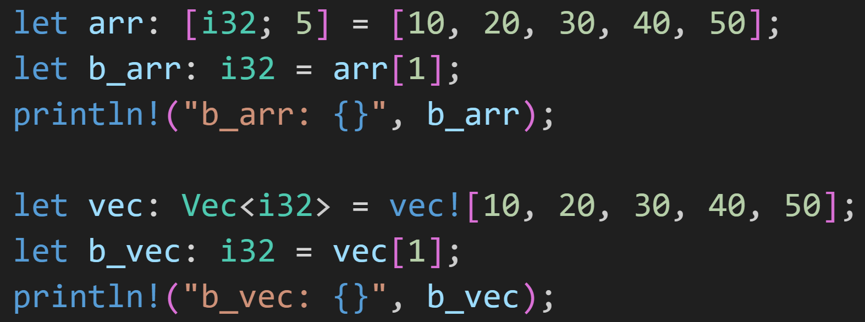
2. Arrays and Vectors - Getting/Setting
Thanks to Traits, the Syntax for getting elements is the same for Arrays and Vectors
Indices are always type usize
©Philippe Felix Haupt 2023

Slide 86
2. Arrays and Vectors - Getting/Setting
Thanks to Traits, the Syntax for getting elements is the same for Arrays and Vectors
Indices are always type usize
Get element at index 1
Get element at index 1
©Philippe Felix Haupt 2023

Slide 87
2. Arrays and Vectors - Getting/Setting
Thanks to Traits, the Syntax for getting elements is the same for Arrays and Vectors
Indices are always type usize
1/3
What does this print?
What does this print?
©Philippe Felix Haupt 2023

Slide 88
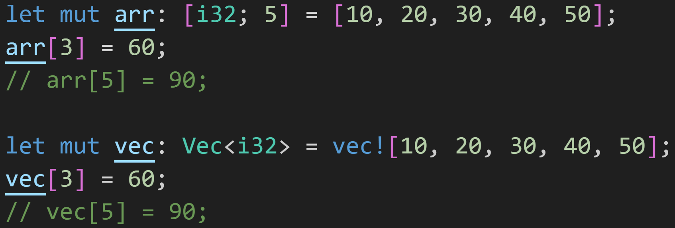
2. Arrays and Vectors - Getting/Setting
Thanks to Traits, the Syntax for setting elements is the same for Arrays and Vectors
Indices are always type usize
©Philippe Felix Haupt 2023

Slide 89
2. Arrays and Vectors - Getting/Setting
Thanks to Traits, the Syntax for setting elements is the same for Arrays and Vectors
Indices are always type usize
Set the element at index 3 to 60
Set the element at index 3 to 60
©Philippe Felix Haupt 2023

Slide 90
2. Arrays and Vectors - Getting/Setting
Thanks to Traits, the Syntax for setting elements is the same for Arrays and Vectors
Indices are always type usize
This would crash the program!
The index is out of bounds!
This would crash the program!
The index is out of bounds!
©Philippe Felix Haupt 2023

Slide 91
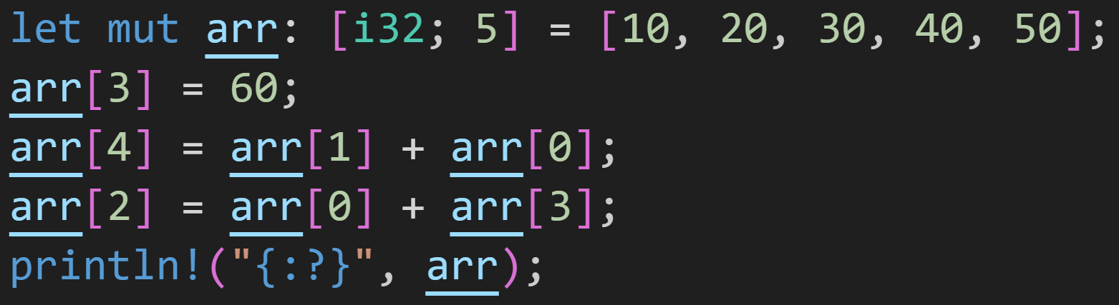
2. Arrays and Vectors - Getting/Setting
Thanks to Traits, the Syntax for setting elements is the same for Arrays and Vectors
Indices are always type usize
2/3
What does the array look like here?
©Philippe Felix Haupt 2023

Slide 92
2. Arrays and Vectors - Getting/Setting
Thanks to Traits, the Syntax for setting elements is the same for Arrays and Vectors
Indices are always type usize
2/3
60
What does the array look like here?
©Philippe Felix Haupt 2023

Slide 93
2. Arrays and Vectors - Getting/Setting
Thanks to Traits, the Syntax for getting elements is the same for Arrays and Vectors
Indices are always type usize
2/3
60
20
What does the array look like here?
©Philippe Felix Haupt 2023

Slide 94
2. Arrays and Vectors - Getting/Setting
Thanks to Traits, the Syntax for getting elements is the same for Arrays and Vectors
Indices are always type usize
2/3
60
20
10
What does the array look like here?
©Philippe Felix Haupt 2023

Slide 95
2. Arrays and Vectors - Getting/Setting
Thanks to Traits, the Syntax for setting elements is the same for Arrays and Vectors
Indices are always type usize
2/3
60
30
20
10
What does the array look like here?
©Philippe Felix Haupt 2023

Slide 96
2. Arrays and Vectors - Getting/Setting
Thanks to Traits, the Syntax for setting elements is the same for Arrays and Vectors
Indices are always type usize
2/3
70
60
30
20
10
10
60
What does the array look like here?
©Philippe Felix Haupt 2023

Slide 97
2. Arrays and Vectors - Common operations
Arrays and Vectors come with many useful methods
©Philippe Felix Haupt 2023

Slide 98
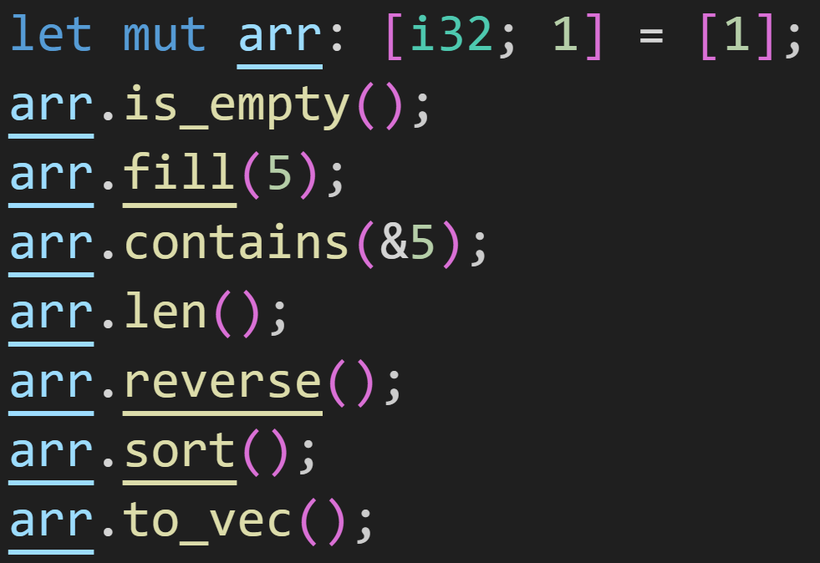
2. Arrays and Vectors - Common operations
Arrays and Vectors come with many useful methods, here a selection:
©Philippe Felix Haupt 2023

Slide 99
2. Arrays and Vectors - Common operations
Arrays and Vectors come with many useful methods, here a selection:
Does the Array contain any elements?
©Philippe Felix Haupt 2023

Slide 100
2. Arrays and Vectors - Common operations
Arrays and Vectors come with many useful methods, here a selection:
Set every element to the specified value
©Philippe Felix Haupt 2023

Slide 101
2. Arrays and Vectors - Common operations
Arrays and Vectors come with many useful methods, here a selection:
Does the array contain the specified value?
Note: It takes a reference, not the value itself
©Philippe Felix Haupt 2023

Slide 102
2. Arrays and Vectors - Common operations
Arrays and Vectors come with many useful methods, here a selection:
Returns the size of the array (in our case 1)
©Philippe Felix Haupt 2023

Slide 103
2. Arrays and Vectors - Common operations
Arrays and Vectors come with many useful methods, here a selection:
Reverses the order of elements
©Philippe Felix Haupt 2023

Slide 104
2. Arrays and Vectors - Common operations
Arrays and Vectors come with many useful methods, here a selection:
Sorts the array
©Philippe Felix Haupt 2023

Slide 105
2. Arrays and Vectors - Common operations
Arrays and Vectors come with many useful methods, here a selection:
Copies the Array and turns it into a Vector
©Philippe Felix Haupt 2023

Slide 106
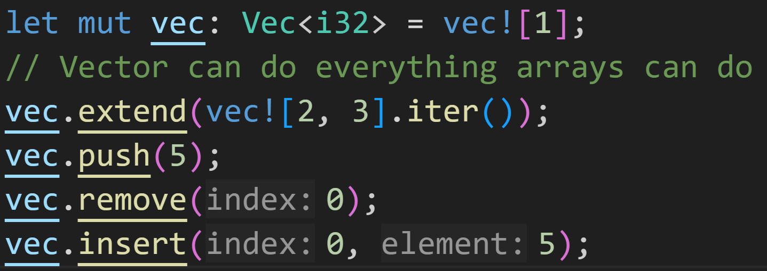
2. Arrays and Vectors - Common operations
Arrays and Vectors come with many useful methods, here a selection:
©Philippe Felix Haupt 2023

Slide 107
2. Arrays and Vectors - Common operations
Arrays and Vectors come with many useful methods, here a selection:
Pushes all elements of an iterator, here vec would be [1, 2, 3] after this line
(More on iterators later)
©Philippe Felix Haupt 2023

Slide 108
2. Arrays and Vectors - Common operations
Arrays and Vectors come with many useful methods, here a selection:
Adds this element to the vector, here vec would be [1, 2, 3, 5] after this line
©Philippe Felix Haupt 2023

Slide 109
2. Arrays and Vectors - Common operations
Arrays and Vectors come with many useful methods, here a selection:
Remove element at given index, here vec would be [2, 3, 5] after this line
©Philippe Felix Haupt 2023

Slide 110
2. Arrays and Vectors - Common operations
Arrays and Vectors come with many useful methods, here a selection:
Insert element at given index and shift the rest, here vec would be [5, 2, 3, 5] after this line
©Philippe Felix Haupt 2023

Slide 111
2. Arrays and Vectors - Common operations
Arrays and Vectors come with many useful methods
The ones I didn’t show go beyond the scope of this course
©Philippe Felix Haupt 2023

Slide 112
Intermission: Exercise
Time for an exercise!
©Philippe Felix Haupt 2023

Slide 113
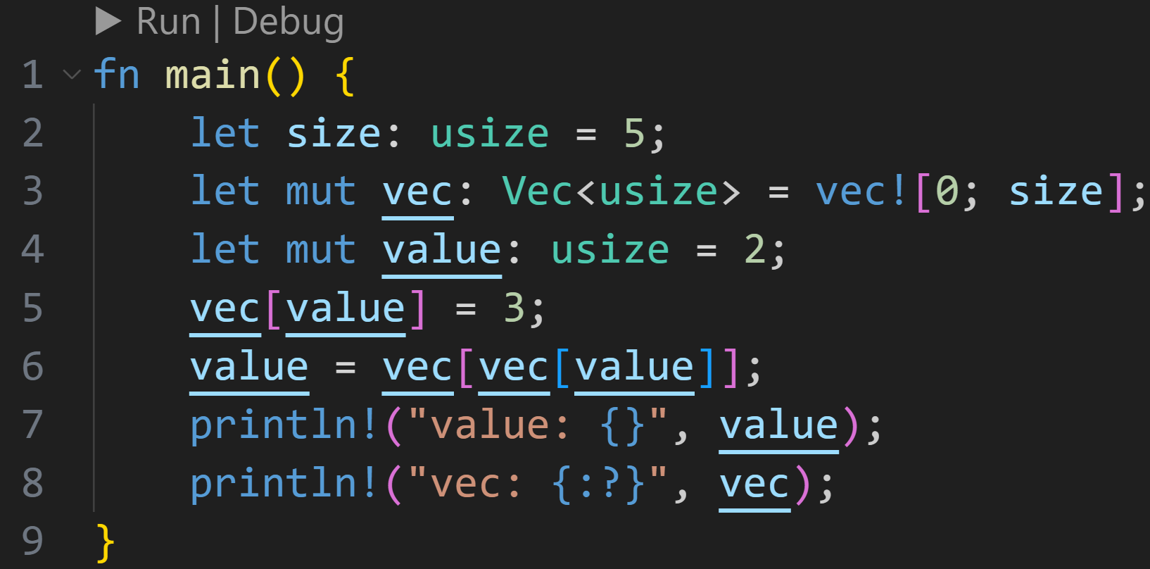
Intermission: Exercise
Time for an exercise!
2/3
©Philippe Felix Haupt 2023

Slide 114
Intermission: Exercise
Time for an exercise!
2/3
Given that this compiles, what does it print in the end?
©Philippe Felix Haupt 2023

Slide 115
Intermission: Exercise
Time for an exercise!
2/3
Given that this compiles, what does it print in the end?
value: 2, vec: [0, 0, 0, 0, 0]
©Philippe Felix Haupt 2023

Slide 116
Intermission: Exercise
Time for an exercise!
2/3
Given that this compiles, what does it print in the end?
value: 2, vec: [0, 0, 3, 0, 0]
©Philippe Felix Haupt 2023

Slide 117
Intermission: Exercise
Time for an exercise!
2/3
Given that this compiles, what does it print in the end?
vec[value] = 3
©Philippe Felix Haupt 2023

Slide 118
Intermission: Exercise
Time for an exercise!
2/3
Given that this compiles, what does it print in the end?
vec[value] = 3
vec[3] = 0
©Philippe Felix Haupt 2023

Slide 119
Intermission: Exercise
Time for an exercise!
2/3
Given that this compiles, what does it print in the end?
value: 0, vec: [0, 0, 3, 0, 0]
©Philippe Felix Haupt 2023

Slide 120
Intermission: Exercise
Time for an exercise!
2/3
Given that this compiles, what does it print in the end?
value: 0
©Philippe Felix Haupt 2023

Slide 121
Intermission: Exercise
Time for an exercise!
2/3
Given that this compiles, what does it print in the end?
value: 0
vec: [0, 0, 3, 0, 0]
©Philippe Felix Haupt 2023

Slide 122
3. Next time
Doing the same thing over and over again:
loop
while
for
©Philippe Felix Haupt 2023

